Slide 1
Pitch Estimation
Prepared by
Tasnim Nishat Islam
170692
Codes available at : https://github.com/tasnimislam/1706092_dsp_projects.git

Slide 2
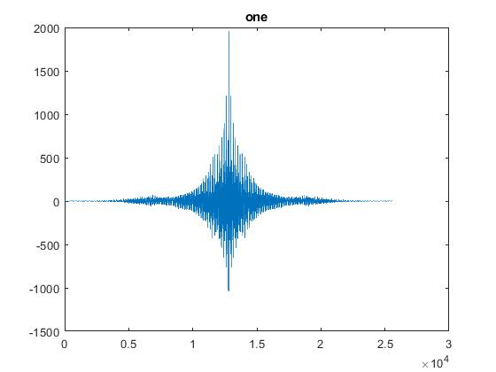
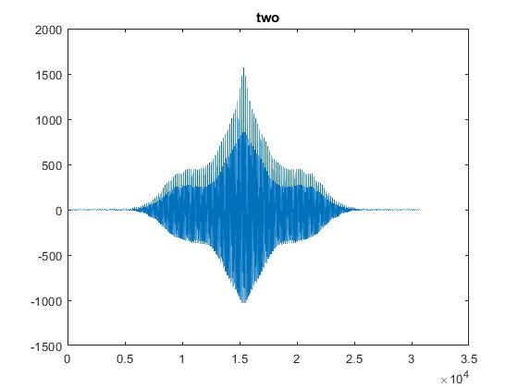
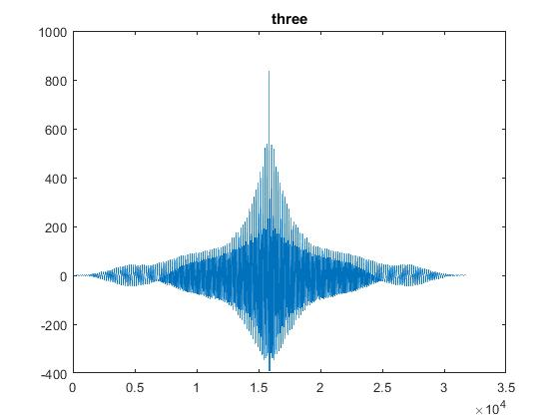
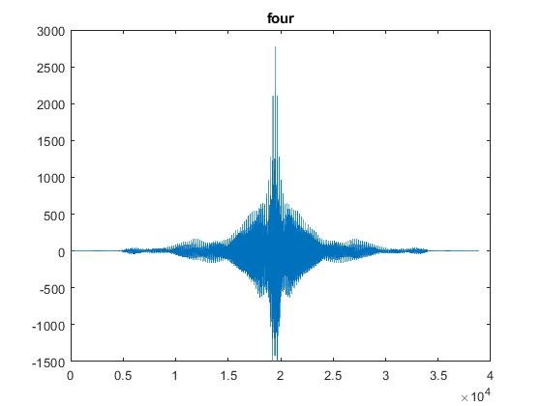
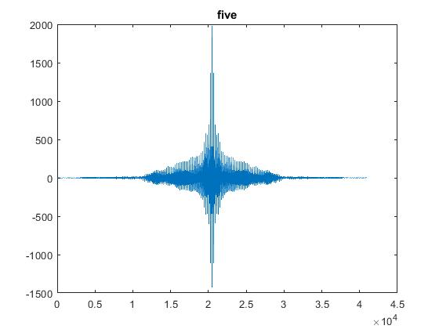
XCORR: Only the signals

Slide 3
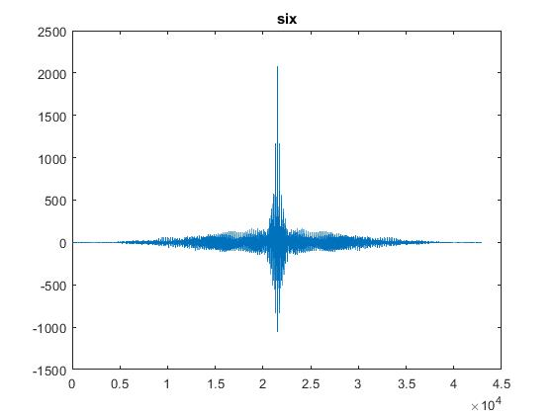
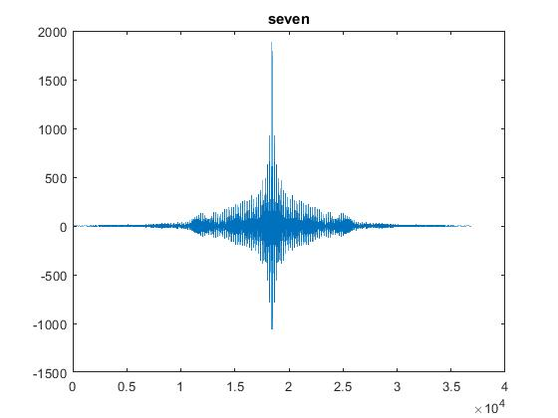
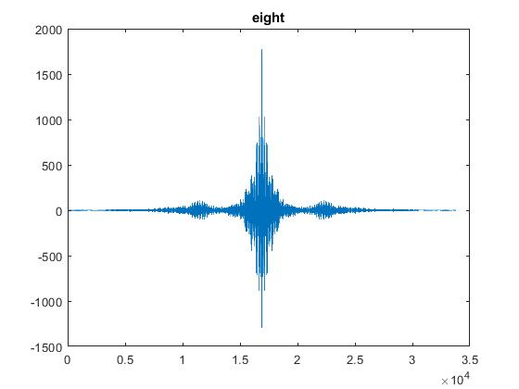
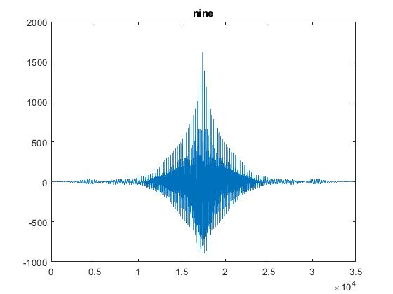
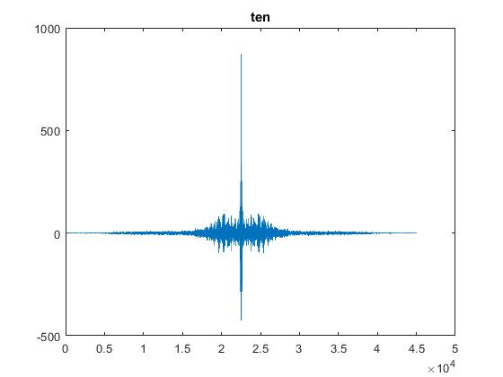
XCORR: Only the signals

Slide 4
Pitch estimation
1706092
Number | Pitch
One | 196
Two | 207
Three | 204
Four | 196
Five | 203
Six | 198
Seven | 206
Eight | 208
Nine | 206
Ten | 64

Slide 5
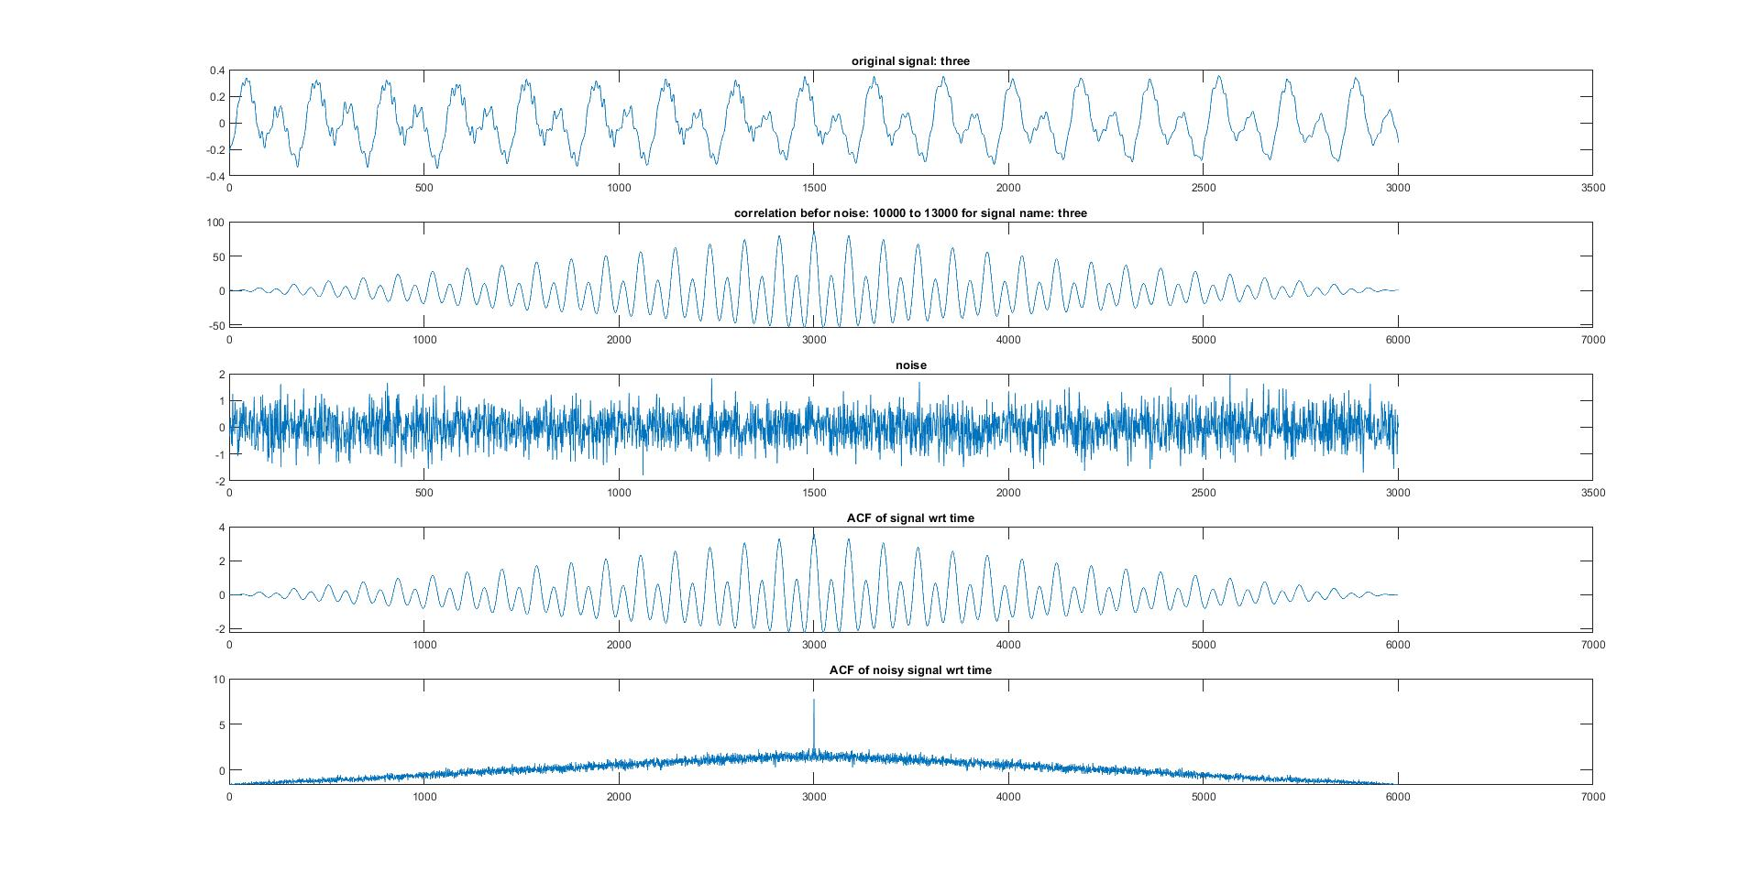
ACF plot for three

Slide 6
Length of vowel: LPC analysis
*all signals are resampled to 8000HZ
Word | Vowel | Frequency
 |  | F1 | F2 | F3
One | /ae/ | 0.36138 = 460 | 0.6054 = 770 | 0.849 = 1080
Two | /ui/ | 0.207 = 263 | 0.496 =631.5 | 0.806 = 1026
Three | /i/ | 0.09 = 114.5880 | 0.19= 241.908 | 0.39=396.5480
Four | /a/ | 0.30=382.0 | 0.609=775 | 0.83=1056
Five | /a/ | 0.15=190.98 | 0.27=343.674 | 0.5019=639.0191
Six | /oy/ | 0.28=356.4960 | 0.45=572.9400 | 0.7089=902.5715
Seven | /a/ | 0.13=165.5160 | 0.326=415.0632 | 0.468=595.8576
Eight | /a/ | 0.13=165.5160 | 0.34=432.880 | 0.488=621.3216
Nine | /oy/ | 0.144=183.3408 | 0.26=331.0320 | 0.39=496.5480
Ten | /o/ | 0.2539=323.3 | 0.449=571.7 | 0.826=1051.7

Slide 7
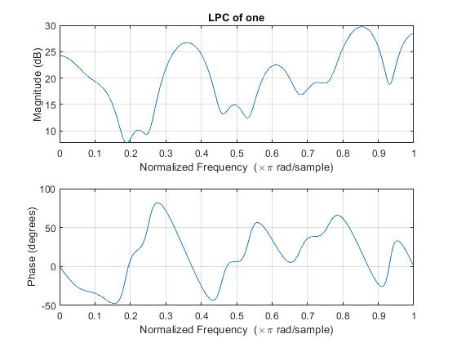
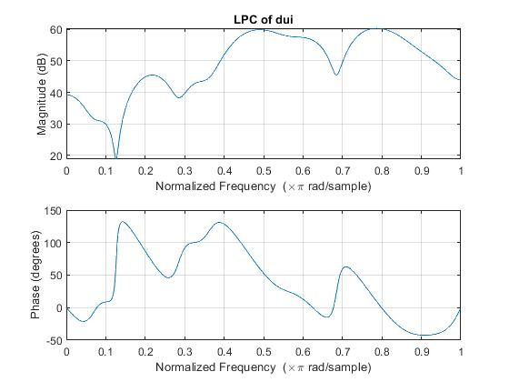
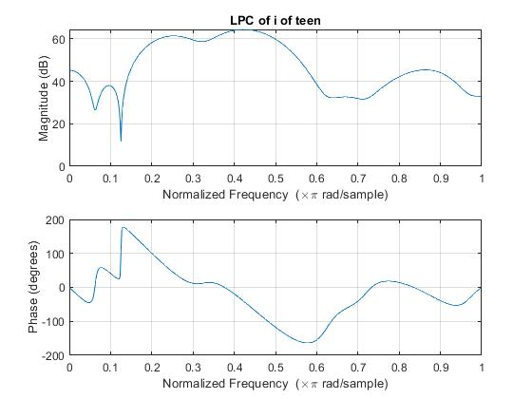
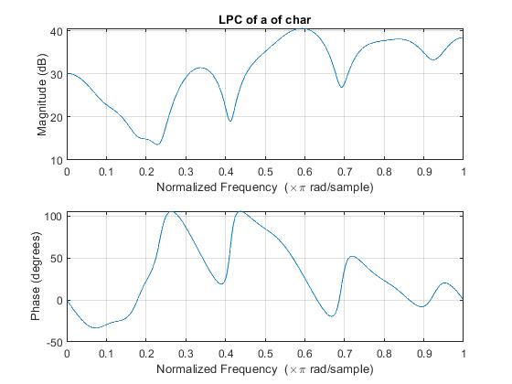
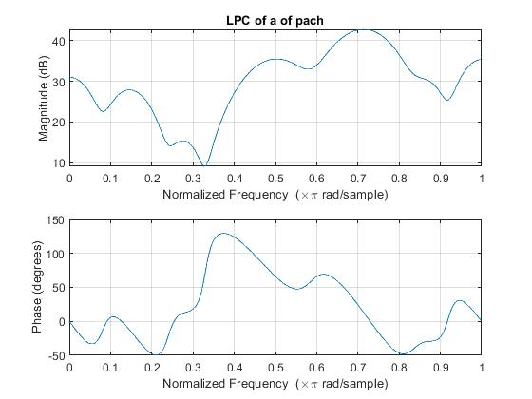
FRETZ CURVE

Slide 8
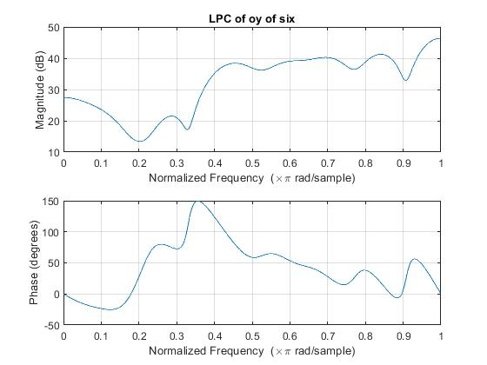
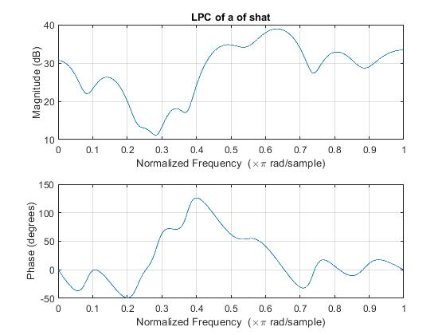
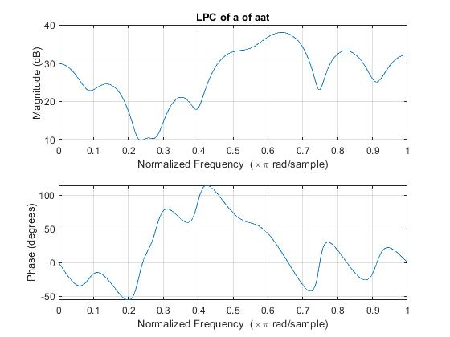
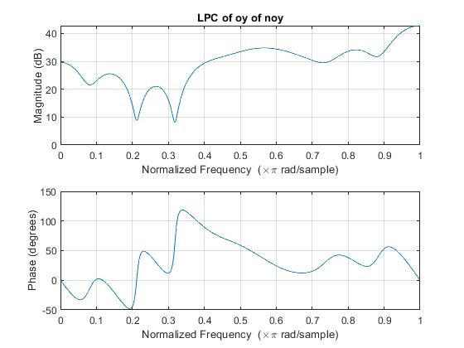
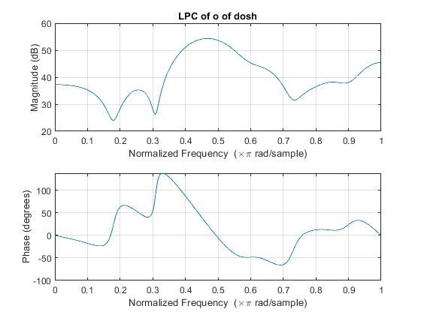
FRETZ CURVE

